Slide 1
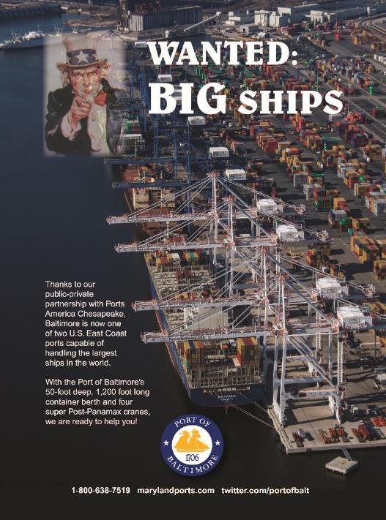
Maryland Port Administration
WANTED: BIG SHIPS
Advertisement - Single

